Slide 1
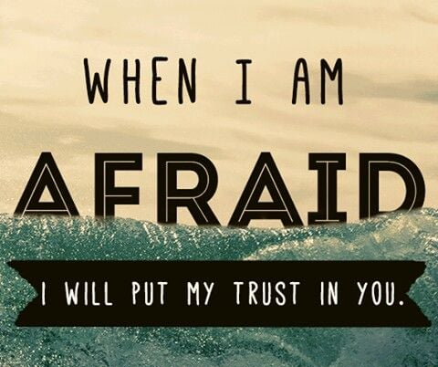
Ps 56

Slide 2
Too many AGAINST you.
You are not enough!
Never forget WHO is WITH you.
  Psalm 23:4a Yea, though I walk through the valley of the shadow of death, I will fear no evil: for thou art with me;
Never forget WHAT He has PROMISED you.
  Isaiah 26:3 Thou wilt keep him in perfect peace, whose mind is stayed on thee: because he trusteth in thee.

Slide 3
Don’t fear what others can do to you.
They can touch you.
  Matthew 10:28 And fear not them which kill the body, but are not able to kill the soul: but rather fear him which is able to destroy both soul and body in hell.
They can twist what you say.
  Titus 1:15-16 Unto the pure all things are pure: but unto them that are defiled and unbelieving is nothing pure; but even their mind and conscience is defiled.
  John 15:19 If ye were of the world, the world would love his own: but because ye are not of the world, but I have chosen you out of the world, therefore the world hateth you.
They can entrap you.

Slide 4
God knows and is keeping the score!
God sees everything related to you!
Others can do things against you. So what?
The question is: “What can you do with God?”
The God who saved you will keep you!
  2 Corinthians 1:10 Who delivered us from so great a death, and doth deliver: in whom we trust that he will yet deliver us;

Slide 5
Ps 56

